Slide 1

NeuroDOT 2.2.0 Base
Appendix - HW Sample 2 Results

Slide 2
Introduction
This appendix is intended to provide a simple "gold standard" against which advanced users can compare their own results when using NeuroDOT 2.2.0 Base.
This will be presented as a series of visualization screenshots.

Slide 3
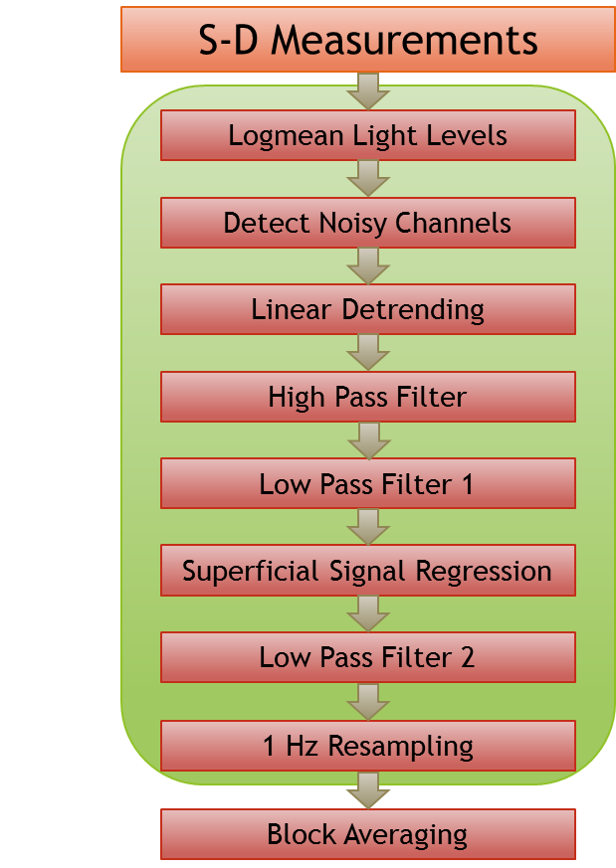
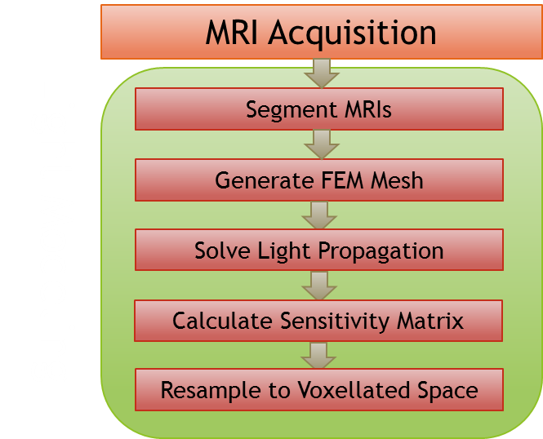
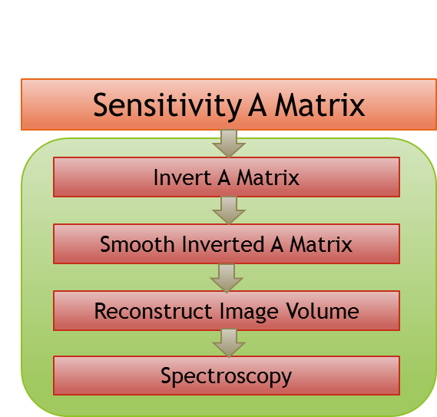
NeuroDOT 2 Overview Flowchart

Slide 4
Preprocessing Pipeline Flowchart
S-D Measurements
Logmean Light Levels
Detect Noisy Channels
Linear Detrending
High Pass Filter
Low Pass Filter 1
Superficial Signal Regression
Low Pass Filter 2
1 Hz Resampling
Block Averaging

Slide 5
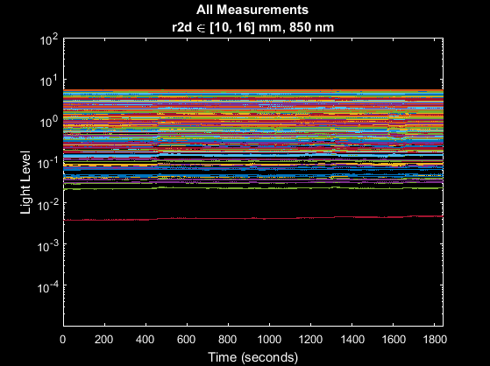
S-D Measurements

Slide 6
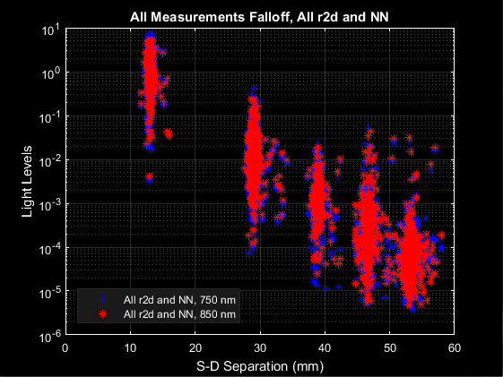
S-D Measurements

Slide 7
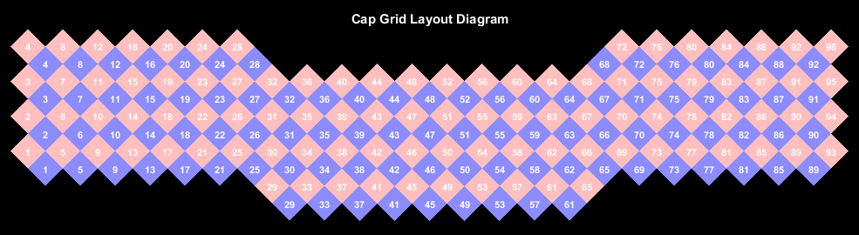
S-D Measurements

Slide 8
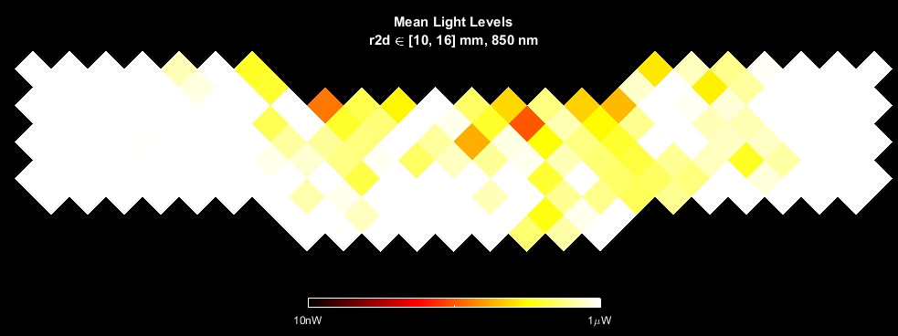
S-D Measurements

Slide 9
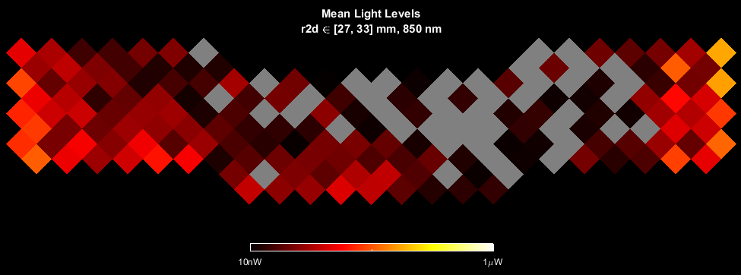
S-D Measurements

Slide 10
Preprocessing Pipeline Flowchart
S-D Measurements
Logmean Light Levels
Detect Noisy Channels
Linear Detrending
High Pass Filter
Low Pass Filter 1
Superficial Signal Regression
Low Pass Filter 2
1 Hz Resampling
Block Averaging

Slide 11
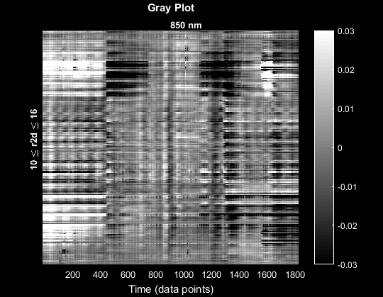
Logmean

Slide 12
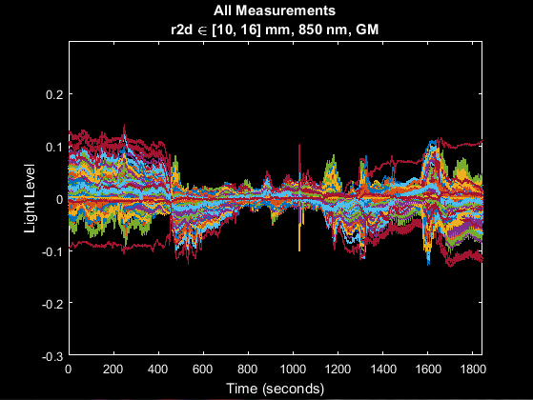
Logmean

Slide 13
Preprocessing Pipeline Flowchart
S-D Measurements
Logmean Light Levels
Detect Noisy Channels
Linear Detrending
High Pass Filter
Low Pass Filter 1
Superficial Signal Regression
Low Pass Filter 2
1 Hz Resampling
Block Averaging

Slide 14
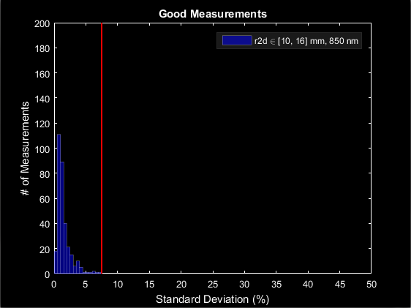
Good Measurements

Slide 15
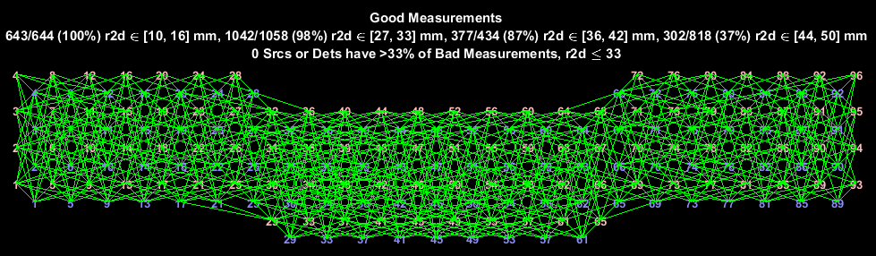
Good Measurements

Slide 16
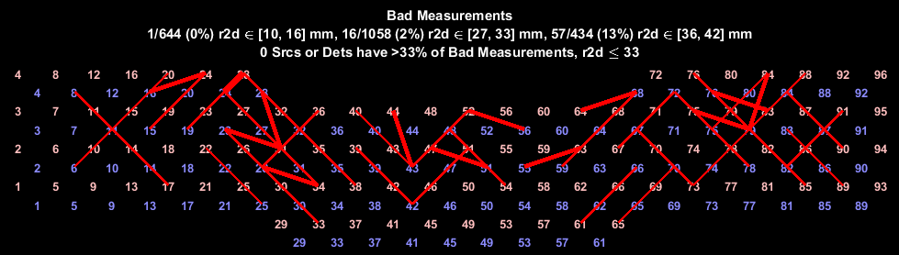
Good Measurements

Slide 17
Preprocessing Pipeline Flowchart
S-D Measurements
Logmean Light Levels
Detect Noisy Channels
Linear Detrending
High Pass Filter
Low Pass Filter 1
Superficial Signal Regression
Low Pass Filter 2
1 Hz Resampling
Block Averaging

Slide 18
Preprocessing Pipeline Flowchart
S-D Measurements
Logmean Light Levels
Detect Noisy Channels
Linear Detrending
High Pass Filter
Low Pass Filter 1
Superficial Signal Regression
Low Pass Filter 2
1 Hz Resampling
Block Averaging

Slide 19
Preprocessing Pipeline Flowchart
S-D Measurements
Logmean Light Levels
Detect Noisy Channels
Linear Detrending
High Pass Filter
Low Pass Filter 1
Superficial Signal Regression
Low Pass Filter 2
1 Hz Resampling
Block Averaging

Slide 20
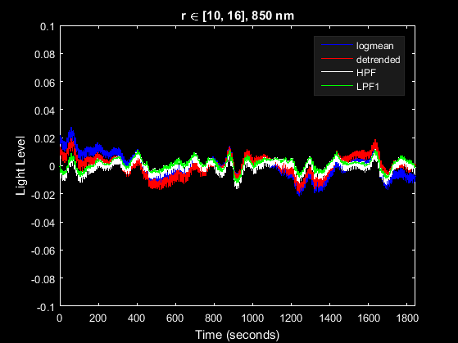
LPF1

Slide 21
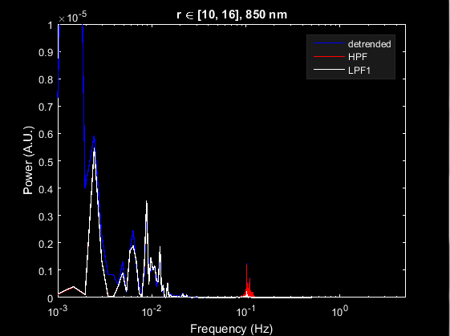
LPF1

Slide 22
Preprocessing Pipeline Flowchart
S-D Measurements
Logmean Light Levels
Detect Noisy Channels
Linear Detrending
High Pass Filter
Low Pass Filter 1
Superficial Signal Regression
Low Pass Filter 2
1 Hz Resampling
Block Averaging

Slide 23
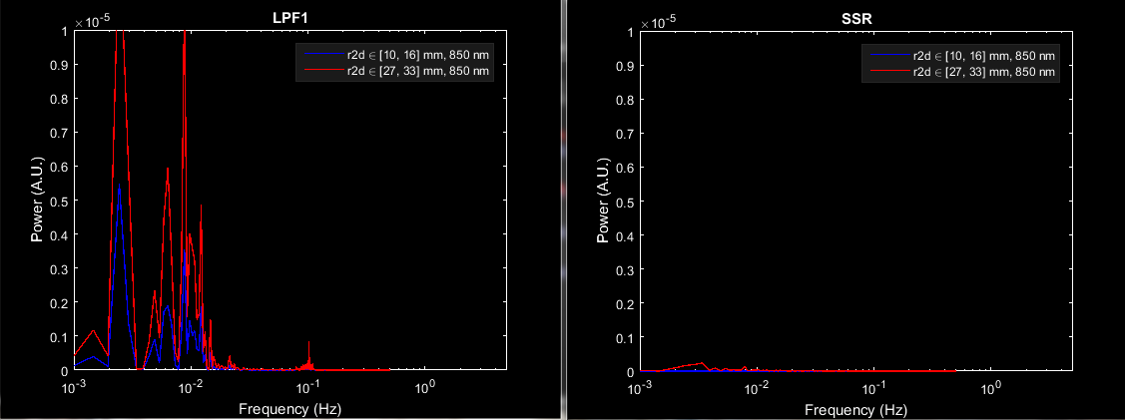
SSR

Slide 24
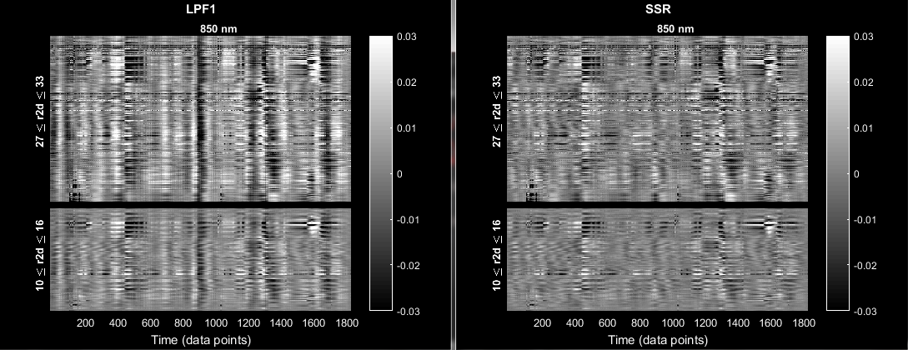
SSR

Slide 25
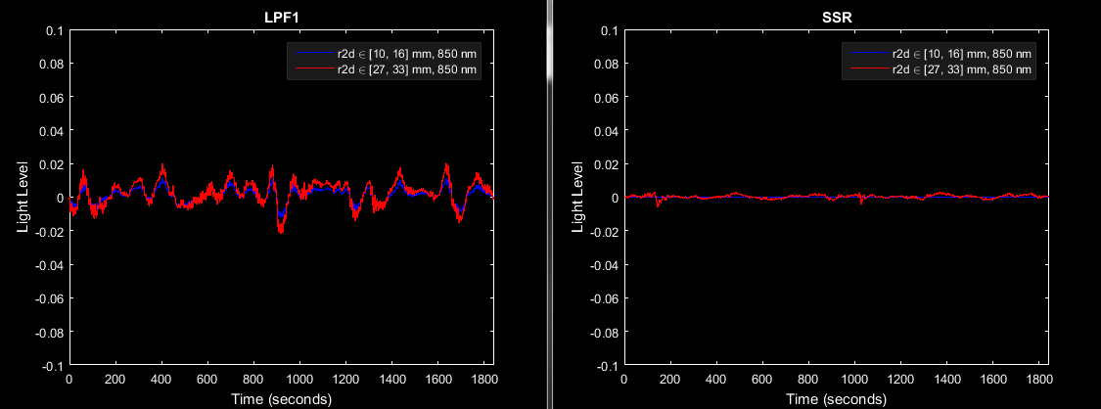
SSR

Slide 26
Preprocessing Pipeline Flowchart
S-D Measurements
Logmean Light Levels
Detect Noisy Channels
Linear Detrending
High Pass Filter
Low Pass Filter 1
Superficial Signal Regression
Low Pass Filter 2
1 Hz Resampling
Block Averaging

Slide 27
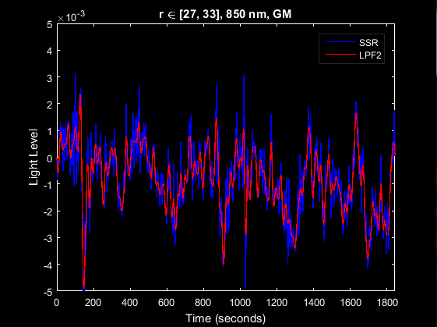
LPF2

Slide 28
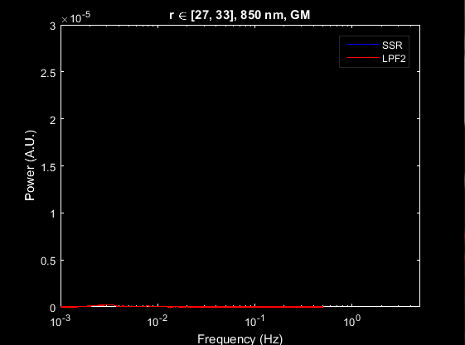
LPF2

Slide 29
Preprocessing Pipeline Flowchart
S-D Measurements
Logmean Light Levels
Detect Noisy Channels
Linear Detrending
High Pass Filter
Low Pass Filter 1
Superficial Signal Regression
Low Pass Filter 2
1 Hz Resampling
Block Averaging

Slide 30
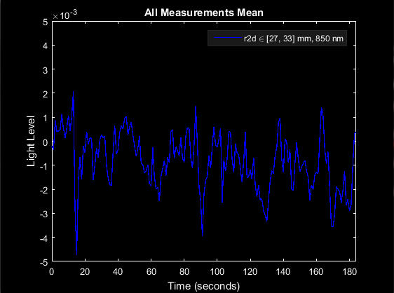
1 Hz Resampling

Slide 31
Preprocessing Pipeline Flowchart
S-D Measurements
Logmean Light Levels
Detect Noisy Channels
Linear Detrending
High Pass Filter
Low Pass Filter 1
Superficial Signal Regression
Low Pass Filter 2
1 Hz Resampling
Block Averaging

Slide 32
Block Averaging

Slide 33
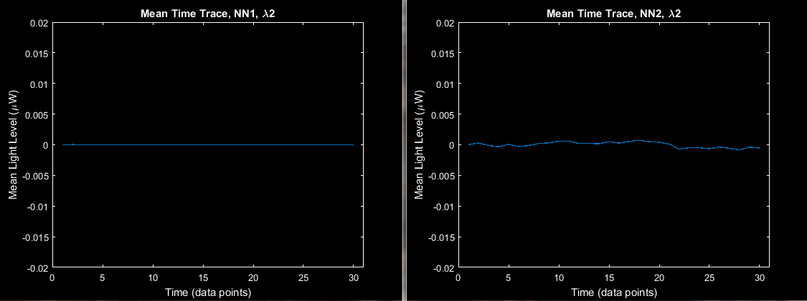
Block Averaging

Slide 34
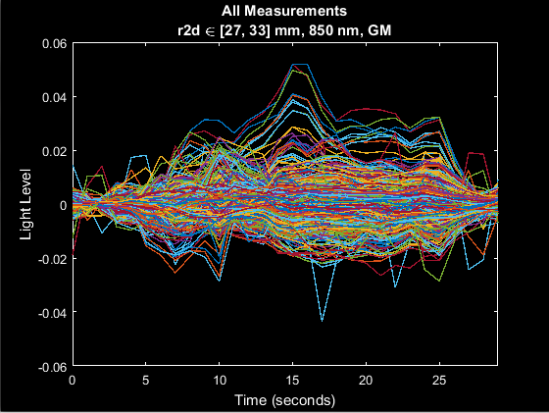
Block Averaging

Slide 35
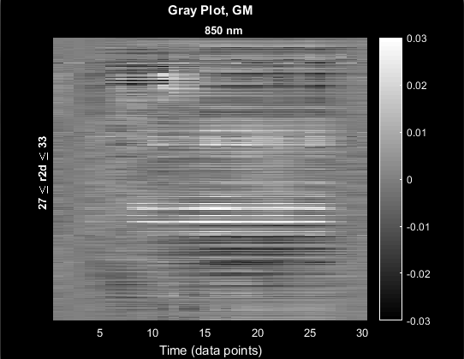
Block Averaging

Slide 36
Preprocessing Pipeline Flowchart
S-D Measurements
Logmean Light Levels
Detect Noisy Channels
Linear Detrending
High Pass Filter
Low Pass Filter 1
Superficial Signal Regression
Low Pass Filter 2
1 Hz Resampling
Block Averaging

Slide 37
That’s It (Again)
For further questions or more information, please consult the NeuroDOT 2.2.0 Base User Manual and the various Appendices.
NeuroDOT 2 Support Team:
Adam Eggebrecht (aeggebre@wustl.edu)
David Muccigrosso (muccigrosso.david@wustl.edu)

